Slide 1
LAWYERS AT THE CROSSROADS: GOVERNMENT ETHICS & THE RULES OF PROFESSIONAL CONDUCT
Dan Gilbert, Office of Legislative Counsel
Amber Hollister, Oregon State Bar
Oregon State Capitol
December 6, 2019

Slide 2
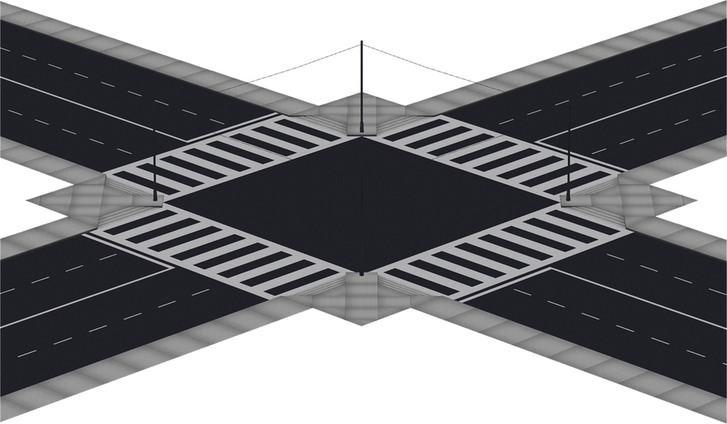
Remember to Look both ways:
REMEMBER TO LOOK BOTH WAYS:
OREGON GOVERNMENT ETHICS LAW, ORS CHAPTER 244
OREGON RULE OF PROFESSIONAL CONDUCT 1.11

Slide 3
WHO REGULATES YOU?
Oregon Government Ethics Commission
Created by Statute
Regulatory Entity Enforcing Oregon Government Ethics Law, Chapter 244
Can Impose Civil Penalties on Public Officials, Lobbyists, and Candidates for Noncompliance
Oregon State Bar
Instrumentality of Judicial Department
Regulatory Entity Enforcing Oregon Rules of Professional Conduct
Can Sanction Lawyers for Professional Misconduct

Slide 4
SPECIAL INFLUENCE
ORS Chapter 244 | RPC 1.11
“but for” prohibition - ORS 244.040(1) | No use of public position to obtain special advantage in legislative matters. RPC 1.11(d)(2)(i)
 | No use of public position to influence tribunal. RPC 1.11(d)(2)(ii)

Slide 5
HYPOTHETICAL 1: LAND USE HEARTBURN
Jane is a legislative staffer and new attorney. She receives a call from her mother, a real estate developer, who is embroiled in a dispute with the Land Use Board of Appeals.
Jane knows her elected enjoys a close personal relationship with a member of the board, Ben Boundary. Jane’s mom suggests that she make a call to Ben to encourage him to make a favorable decision for her mom.
How should Jane analyze this issue?

Slide 6
BRIBES & GIFTS
ORS Chapter 244 | RPC 1.11
“but for” prohibition - ORS 244.040 gift limit – ORS 244.025 | No accepting bribes. RPC 1.11(d)(2)(iii)

Slide 7
HYPOTHETICAL NO. 2: BLAZER FEVER
John is a volunteer member of a local school board, who also happens to be a lawyer. An educational testing vendor offers John courtside tickets to the Blazers. John is over the moon - he is a super fan.
John knows that the vendor is responding to an RFP seeking a contract with the school district, and likely wants his vote to approve the deal.
How should John analyze the issue?

Slide 8
CONFIDENTIAL INFORMATION
ORS Chapter 244 | RPC 1.11
No use of confidential information for personal gain - ORS 244.040(4)&(5) | No using confidential government info to represent private client. RPC 1.11 (c) &(d)(2)(iv)

Slide 9
HYPOTHETICAL NO. 3: SKETCHY DEAL
Harry, an attorney, was previously employed by the Oregon Department of Revenue, where he helped the agency investigate tax fraud. While at DOR, Harry learned that MegaCorp was being audited, and DOR had suspicions it was engaged in tax evasion.
Harry now works for a private law firm, and has been asked to work on a deal with a firm client that is seeking to acquire an asset from MegaCorp.
Based on his prior work for DOR, Harry questions the valuation of the asset. He is not sure whether DOR’s investigation is finished.
How should Harry analyze the situation?

Slide 10
CONFlICTS
ORS Chapter 244 | RPC 1.11
Conflicts provisions – 244.120 | Subject to regular current and former client conflict rules, including self-conflict provisions, RPC 1.11(d)(1) No working on matter you worked on as a private lawyer, without informed consent. RPC 1.11(d)(2)(v)

Slide 11
HYPOTHETICAL NO 4: DIVIDED LOYALTIES
Sam is an attorney in private practice who was appointed by the Governor to serve on a public commission.
During the commission’s public meeting, Sam realizes that a proposed regulation could harm several small businesses he represents as an attorney.
How should Sam analyze the issues? What should he do?

Slide 12
HYPOTHETICAL NO 5: SWITCHING SIDES
Pat formerly worked as an assistant deputy attorney, where she prosecuted misdemeanors and felonies.
She is now in private practice as a criminal defense attorney. She has been approached by Max, who is charged with a DUII because he did not successfully complete diversion. Pat formerly appeared on Max’s case, and offered him diversion.
How should Pat analyze the issue?

Slide 13
EMPLOYMENT
ORS Chapter 244 | RPC 1.11
Subsequent employment, ORS 244.047 Employment after participation in public contracting, ORS 244.040(3) | Limit on negotiating for private employment. RPC 1.11(d)(2)(vi)

Slide 14
HYPOTHETICAL NO 6: SEEKING NEW HORIZONS
Emily is a staffer who is aiding a legislative committee with an ongoing investigation about alleged agency malfeasance.
During the investigation, she becomes an expert on the agency’s service delivery model, programs, and financials.
Near the end of session, Emily is approached by a consultant that has been hired by the agency to turn things around. She would love to take the job.
How should Emily analyze the situation?

Slide 15
2019 LEGISLATION OF INTEREST
SB 478 – Relating to nondisclosure agreements.
HB 2096 – Relating to payment of attorney fees in contested cases involving the Oregon Government Ethics Commission.
HB 2595 – Relating to lobbying by former members of the Legislative Assembly.
HB 3377 – Relating to the legislative branch (Joint Committee on Conduct Legislation).

Slide 16
QUESTIONS?
Dan Gilbert
Office of Legislative Counsel
Amber Hollister
Oregon State Bar ahollister@osbar.org 503.620.0222
@oregonethics
www.osbar.org/ethics

